Slide 1
Building Trust in Fintech: DevSecOps Strategies at Saxo Bank
Jinhong Brejnholt
Chief Cloud Architect

Slide 2
Astruct
At Saxo Bank, the cornerstone of our trading platform's integrity is our DevSecOps approach, which ensures top-tier security and code quality. This talk will highlight our security gates that empower developers to produce secure code from the get-go and govern our platform's continuous evolution. We'll delve into our 'shift left' strategy, which integrates security early in the development process for rapid feedback and enhanced efficiency. Discover how these practices enable us to maintain a secure, reliable, and trustworthy trading environment for our customers and partners.

Slide 3





Slide 4

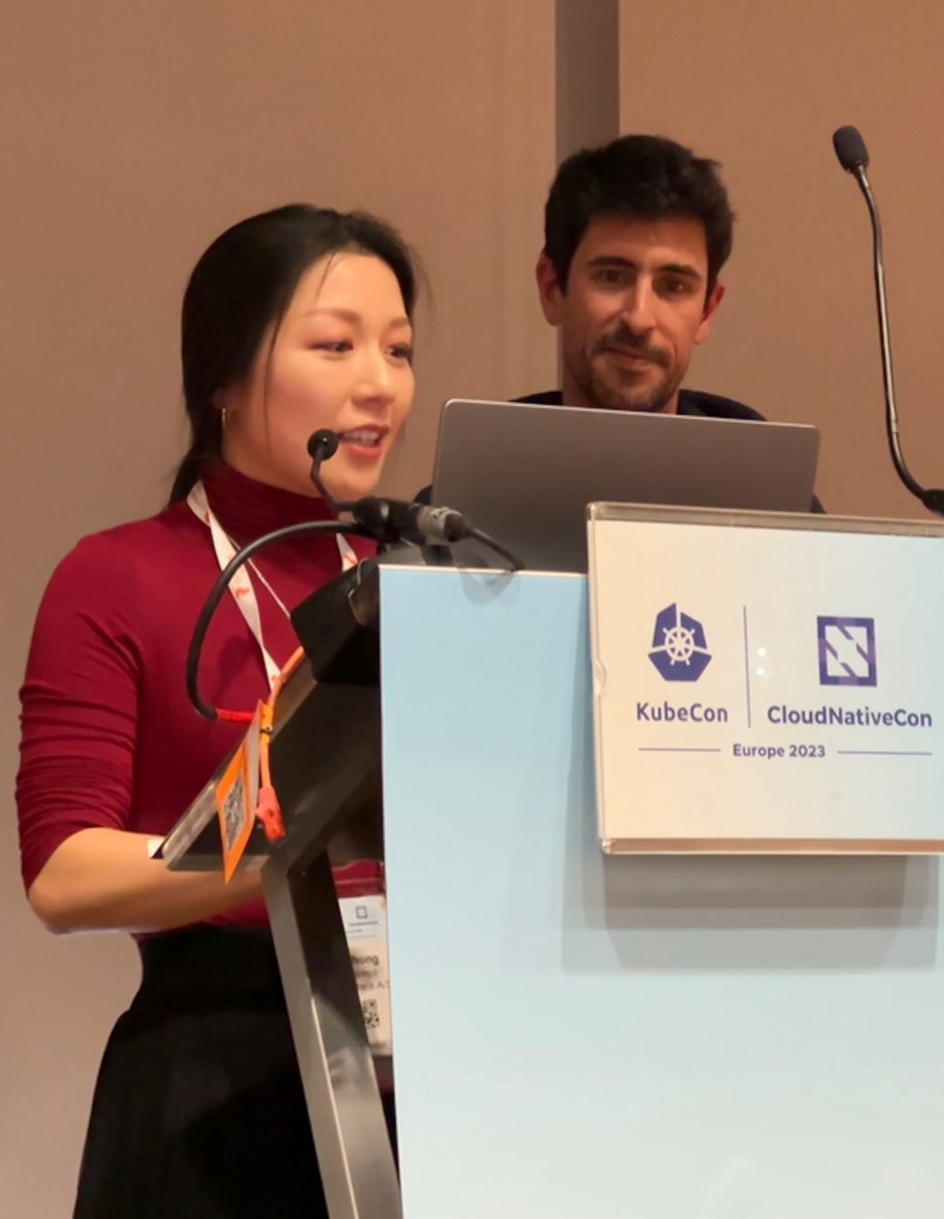
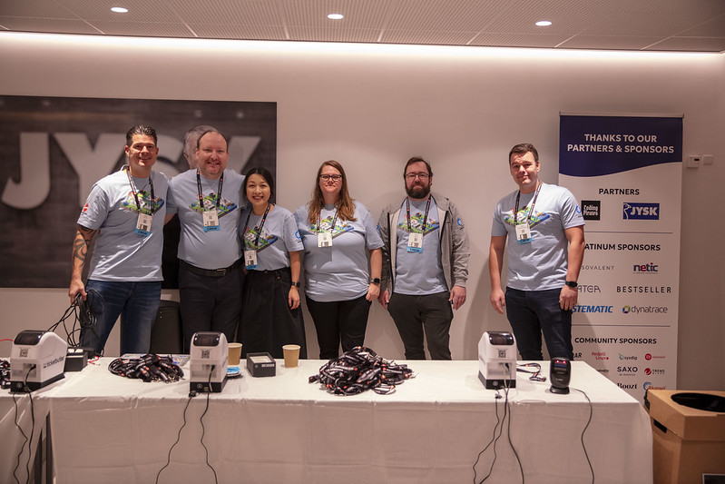
Cloud Native Community
Tuesday, February 2, 20XX

Slide 5

About Saxo
Online trading and investment
17 billion USD daily trade
200+ banks and brokers
1 million clients
DKK 800 billion (USD 116.1 billion) in client assets
Notes:
“Saxo Bank is a very different bank, and we want our environment to reflect that. The T-Rex that hangs in the canteen reminds us that we need to remain agile and be on the leading edge of technology developments so that we can continue to help our clients and partners navigate the global markets. In other words, we cannot become dinosaurs.” --Kim Fournais, CEO and Founder, Saxo Bank
Saxo Bank is a Danish investment bank specializing in online trading and investment. It was founded as a brokerage firm in 1992, under the name Midas Fondsmæglerselskab, by Lars Seier Christensen, Kim Fournais, and Marc Hauschildt. The name was changed to Saxo when the company obtained a banking license in 2001.
Saxo Bank A/S is a fully licensed and regulated Danish bank with an online trading platform that empowers you to invest across global financial markets.

Slide 9
What’s trust
Measurable trust: Mark Burgees trust theory
Priority: https://www.mx.com/blog/what-people-want-from-the-bank-of-the-future/

Slide 10
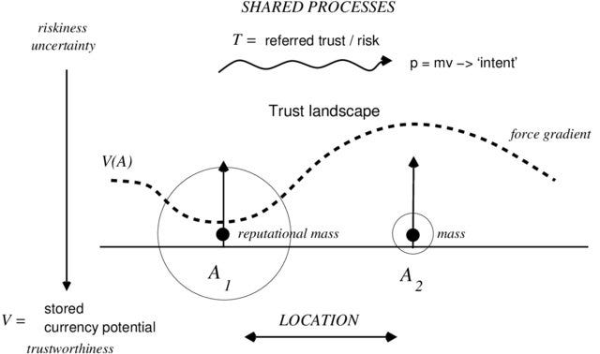
Trust is measurable

Slide 11
Slido
https://admin.sli.do/event/auZ9YFS23QxkKuHgM8aVuz/polls
Participants can vote at Slido.com with #2020022(29 May) or anytime at this link

Slide 12

Trust Before Invest

Slide 13
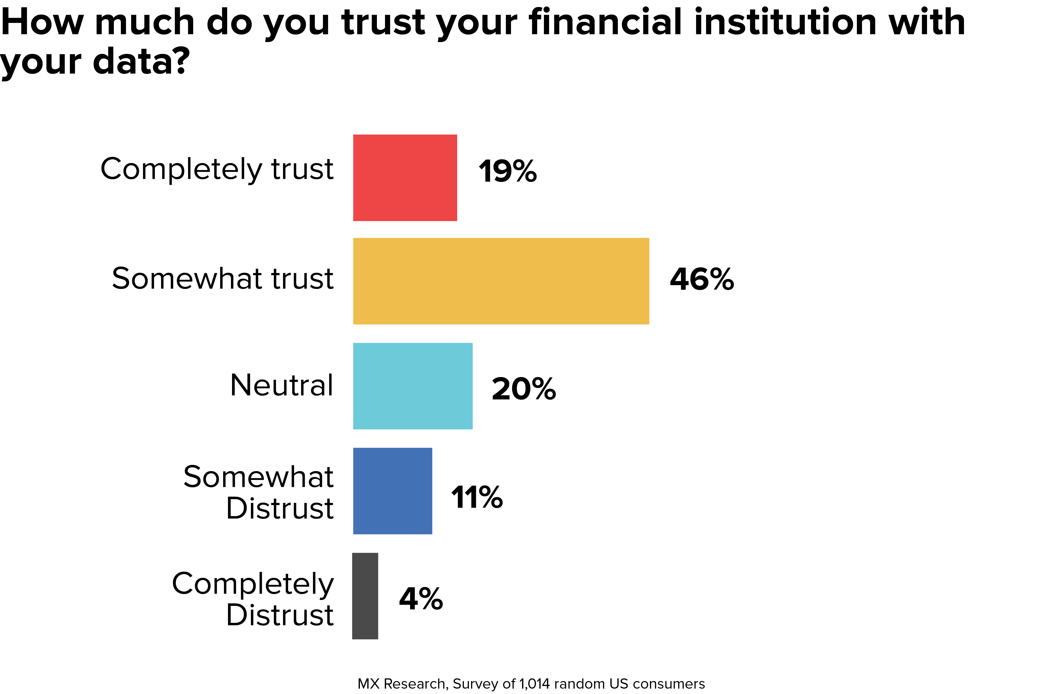

Slide 14
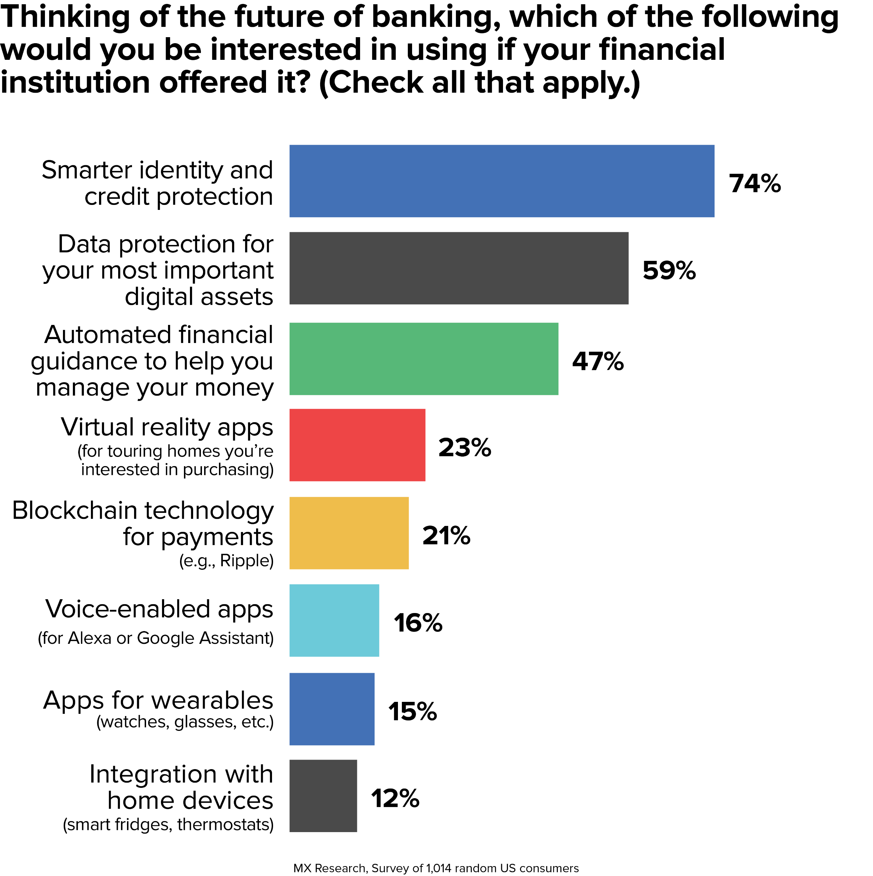
Notes:
2 out of top 3 is security related - how to manage your money comes afterwards
Thinking of the future of banking
Smarter identity and credit protection
Data Protection for your most important digital assets
Automate financial guidance to help you manage your money
Virtual reality apps (for touring homes you’re interested in purchasing)
Blockchain technology for payments
Voice-enabled apps (for Alexa or Google Assistant)
Apps for wareables (watches, glasses, etc)
Integration with home device (smart fridges, thermostats)

Slide 15


Notes:
As an investment bank, we would like to offer the best services - securely

Slide 16
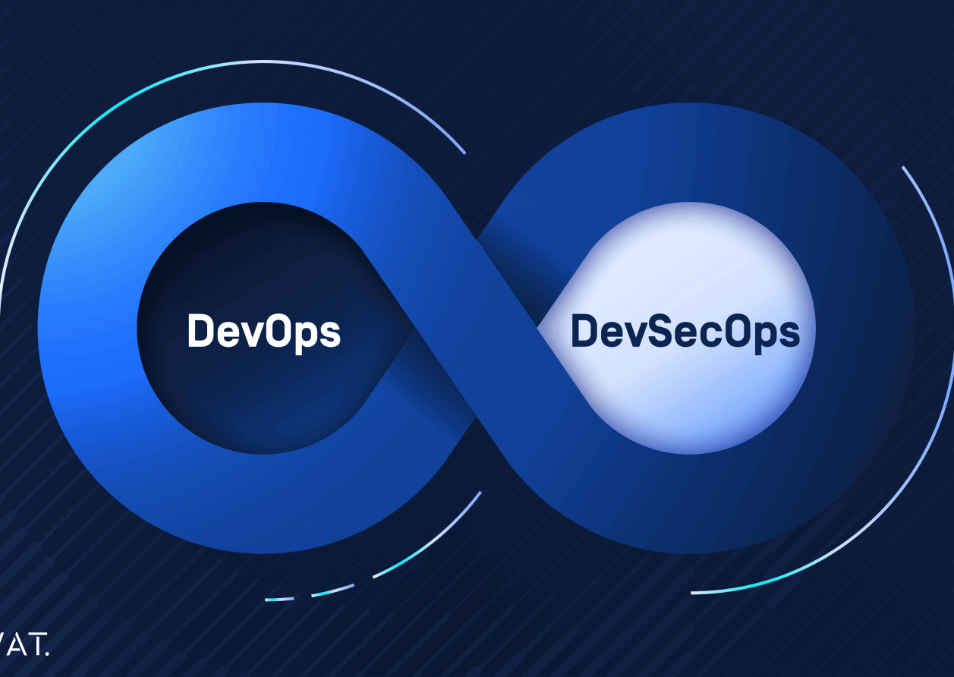
DevSecOps
Development, Security, and Pperations, is a framework that integrates security into all phases of the software development lifecycle.
Notes:
Organizations adopt this approach to reduce the risk of releasing code with security vulnerabilities. Through collaboration, automation, and clear processes, teams share responsibility for security, rather than leaving it to the end when issues can be much more difficult and costly to address.

Slide 17
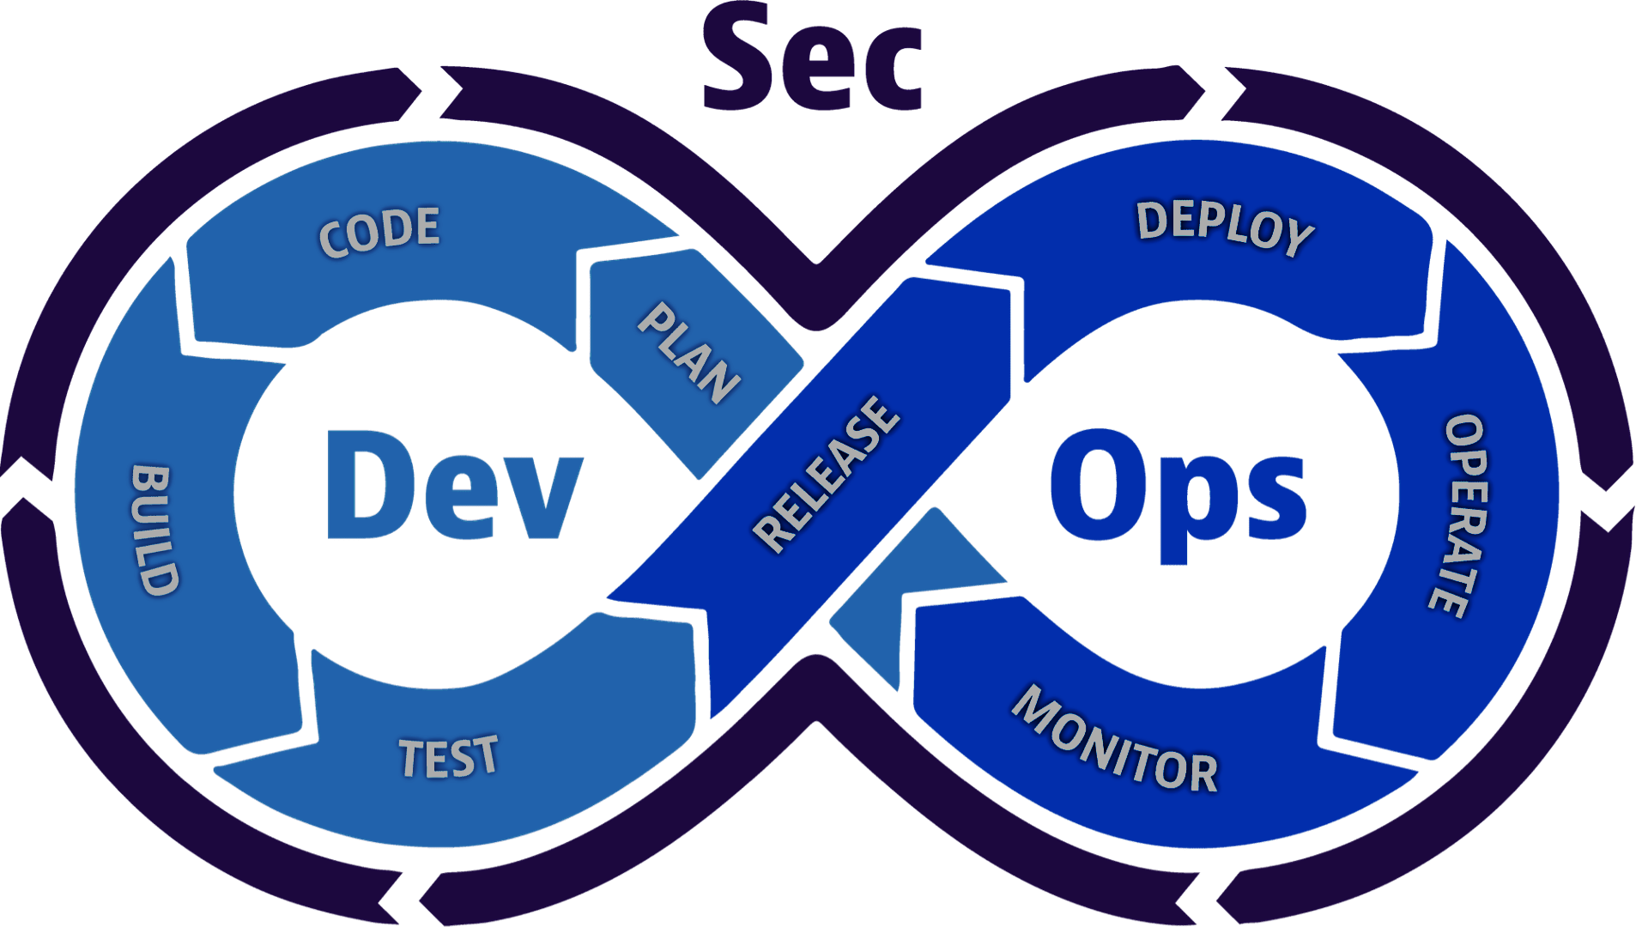
DevSecOps
Notes:
Continuous integration
Continuous delivery
Continuous security
Communication and collaboration

Slide 18
DevSecOps
One Step beyond DevOps
Notes:
Continuous integration
Continuous delivery
Continuous security
Communication and collaboration

Slide 19
The ratio challenge
Dev : Ops : Sec
200 : 5 : 1
Notes:
We are a bank – but we can’t print our own money

Slide 20
Main Steps
Build
Deploy
Run

Slide 21
Build
Build
Deploy
Run
Internal
External
Code Quality
Test Coverage
Vulnerabilities Management
License Compliant

Slide 22
Deploy
Build
Deploy
Run
Vulnerabilities
Change Process
Security & Best Practices
Artifact Integrity
License

Slide 23
Run
Build
Deploy
Run
Vulnerabilities Management
Policies Enforcement
Behavior Monitoring

Slide 24
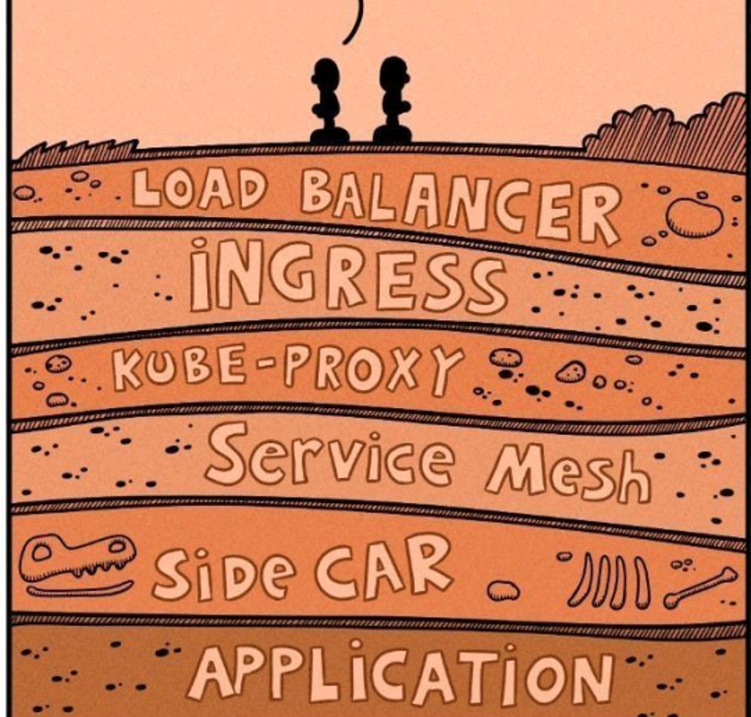
The story doesn’t just end here

Slide 25
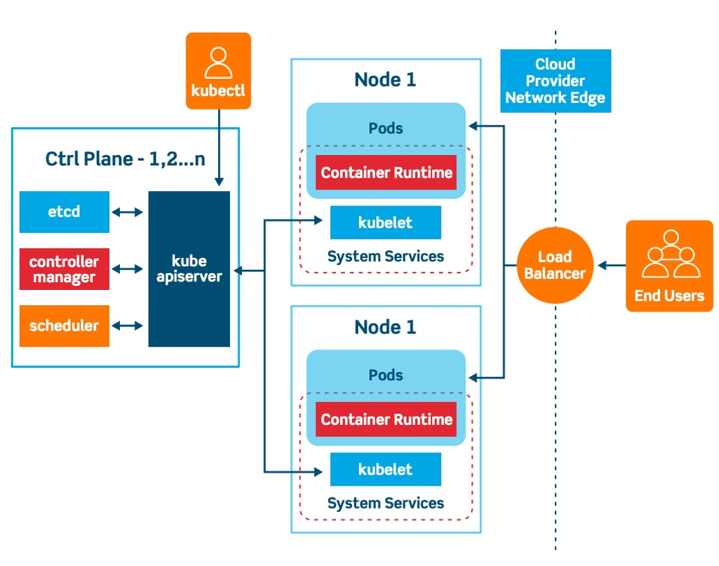
Complex tech stack

Slide 26
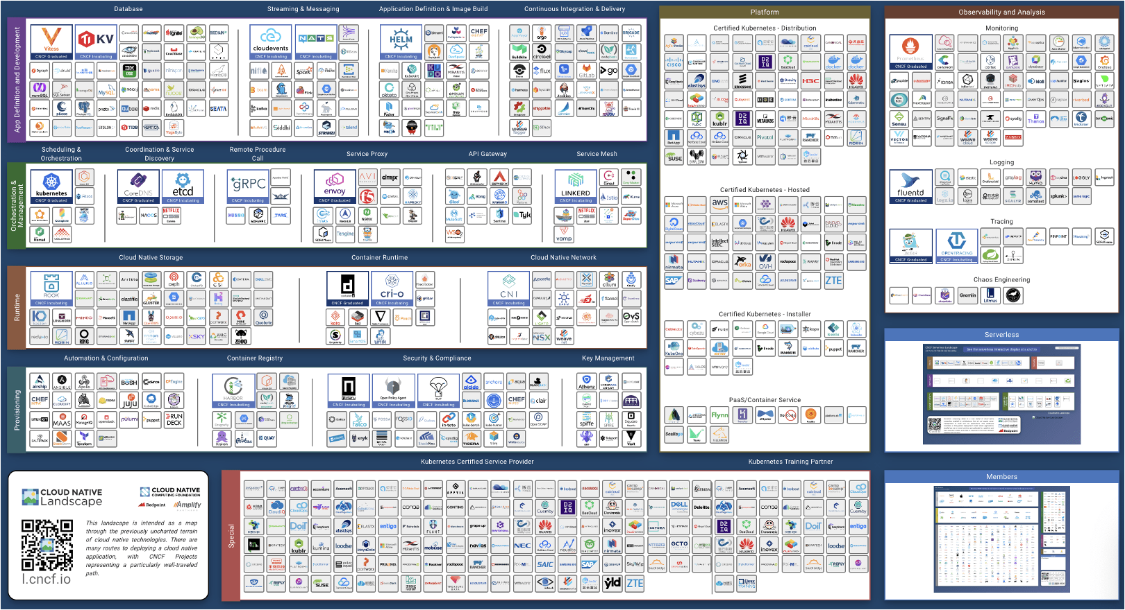

Slide 27
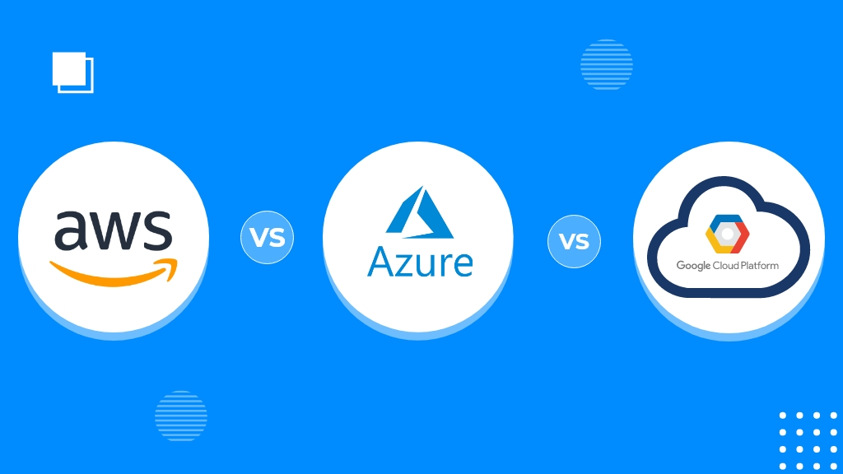

Managed Services
200+
200+
100+

Slide 28


Slide 29

Stack Overflow’s 2020 Developer Survey
Source: https://survey.stackoverflow.co/2020
65K developers
15% - anxiety, depression, or another mental issue
83% of developers report burnout

Slide 30

But we were talking about DevSecOps?

Slide 31


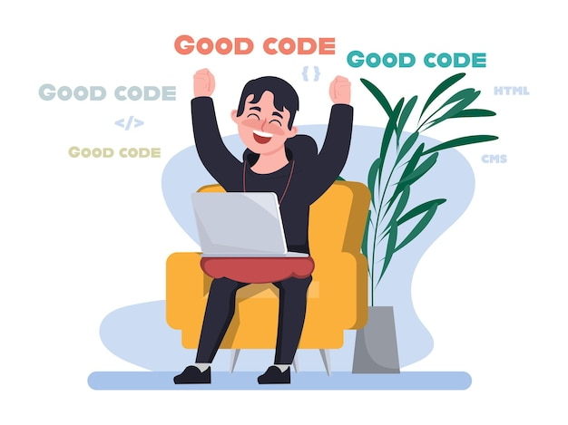

Slide 32

Security as part of the platform offering
Build
Deploy
Run

Slide 33


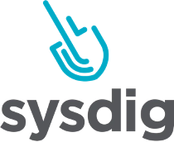

Build
Build
Deploy
Run
Internal
External
Code Quality
Test Coverage
Vulnerabilities Management
License Compliant

Slide 34

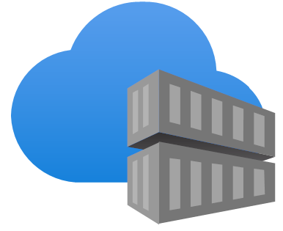


Deploy
Build
Deploy
Run
Vulnerabilities
Change Process
Security & Best Practices
Artifact Integrity
License

Slide 35



Run
Build
Deploy
Run
Vulnerabilities Management
Policies Enforcement
Behavior Monitoring

Slide 37



DevSecOps
Shift Left
Build
Deploy
Run
Notes:
Faster delivery
Improved security posture and integration
Reduced costs
Better product – better trust

Slide 38




DevSecOps
Shift Right
Build
Deploy
Run
Notes:
Production is where most attacks happen.
Scanning source code can’t give you the same rich insights you can get by observing the application when it is running in production.
Some applications you run in production may not have run through your dev environment, so they never had a chance to be scanned by security tools in your dev environment.
To detect new zero-day vulnerabilities, you need to monitor existing applications in your production environment.

Slide 39

Celebrate?

Slide 40

Continue Evaluating and Improving
Notes:
Code/commit signing

Slide 41

Our Recommendation
Built-in security checks, policy as code
Continue upskilling developers and platform engineers
Practice chaos engineering
Start small, and constantly improving
Automation, Automation, Automation

Slide 42

Thank You
Notes:
CPH

Slide 44
The main objective of DevSecOps is to automate, monitor and apply security at all phases of the software lifecycle: plan, develop, build, test, release, deliver, deploy, operate and monitor. Applying security at every stage of the software development process supports CI/CD, reduces the cost of compliance and enables faster software delivery.
DevSecOps means that every employee and team is responsible for security from the outset, and they must make decisions efficiently and put them into action without forfeiting security.

Slide 45
Wait
How to measure?

